Slide 1

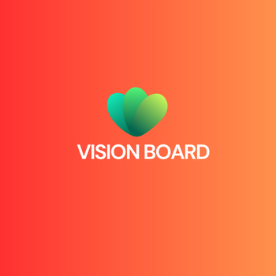
MICROSOFT FABRIC
VISIONBOARD

Slide 2
1
WHAT IS MICROSOFT FABRIC?
End-to-End Analytics: Microsoft Fabric unifies data movement, processing, ingestion, transformation, real-time event routing, and reporting.
Integrated Services: Includes Data Engineering, Data Factory, Data Science, Real-Time Intelligence, Data Warehouse, and Databases.
Seamless & AI-Powered: Provides a user-friendly SaaS experience with embedded AI, reducing manual integration.
Centralized Storage: Uses OneLake to unify and manage data efficiently for better insights.

Slide 3
2
CAPABILITIES OF FABRIC
Role-Specific Workloads: Tailored tools for different organizational roles.
OneLake: Unified data lake for easy management and access.
AI & Automation: Copilot support and Azure AI Foundry for intelligent insights.
Seamless Integration: Works with Microsoft 365 for enhanced collaboration.
Unified Data Management: Centralized governance, sharing, and access.

Slide 4
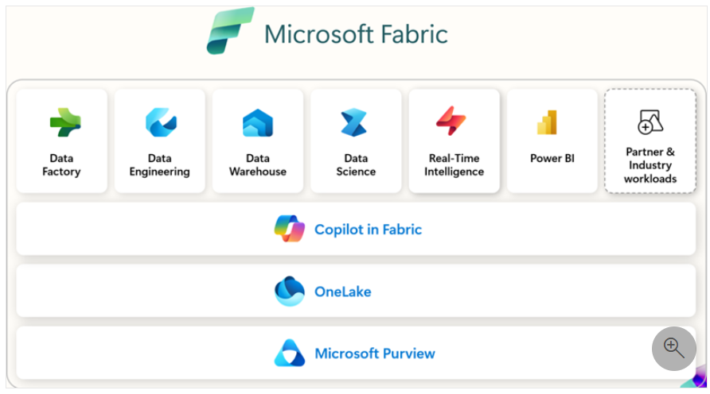
3

Slide 5
4
COMPONENTS OF MICROSOFT FABRIC
Power BI: Connect, visualize, and share data easily for better decision-making.
Databases: Developer-friendly transactional databases with OneLake mirroring for seamless data integration.
Data Factory: Modern data integration with 200+ connectors for cloud and on-premises sources.
Industry Solutions: Tailored data solutions for specific industry needs.
Real-Time Intelligence: End-to-end streaming data solution with real-time analytics and AI integration.
Data Engineering: Spark-based platform for managing, processing, and analyzing large datasets.
Data Science: Build, deploy, and operationalize machine learning models with Azure ML integration.
Data Warehouse: High-performance SQL data warehousing with scalable compute and Delta Lake storage.

Slide 6
5
MICROSOFT FABRIC TERMINOLOGY
General terms
Capacity: Dedicated resources for performing tasks, offered via Fabric SKU and Trials.
Experience: Specific functionality sets like Data Warehouse, Data Engineering, and Power BI.
Item: Components within an experience, such as lakehouse, notebooks, or Spark jobs.
Tenant: A Fabric instance for an organization, linked to Microsoft Entra ID.
Workspace: A collaborative environment for managing and executing items using capacity.

Slide 7
6
CAPACITY
A Microsoft Fabric capacity exists within a tenant, serving as a dedicated pool of resources for that organization. The capacity size determines the available computation power.
With your capacity, you can:
Access all licensed Microsoft Fabric features.
Create and connect Fabric items.
Save and share items in workspaces with appropriately licensed users.
Capacities are categorized into Stock Keeping Units (SKUs), each offering specific Fabric resources. Organizations can have multiple capacities as needed.
The capacity and SKUs table outlines available Microsoft Fabric SKUs, measured in Capacity Units (CU). For Power BI users, the table includes Power BI Premium P SKUs and v-cores, which support Microsoft Fabric. However, A and EM SKUs only support Power BI items.

Slide 8
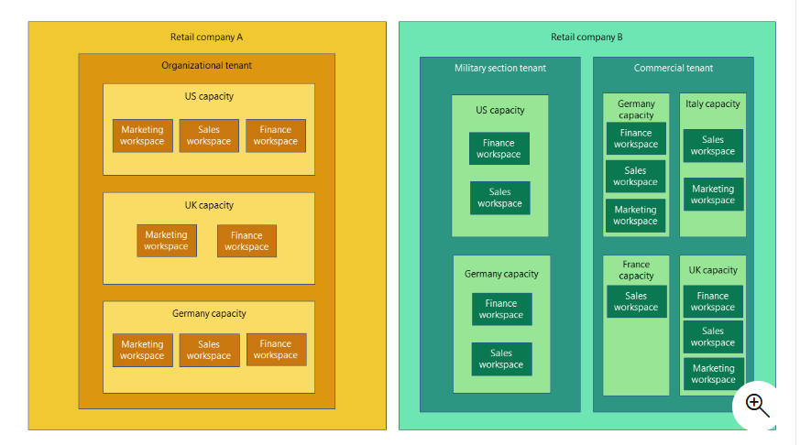
7

Slide 9
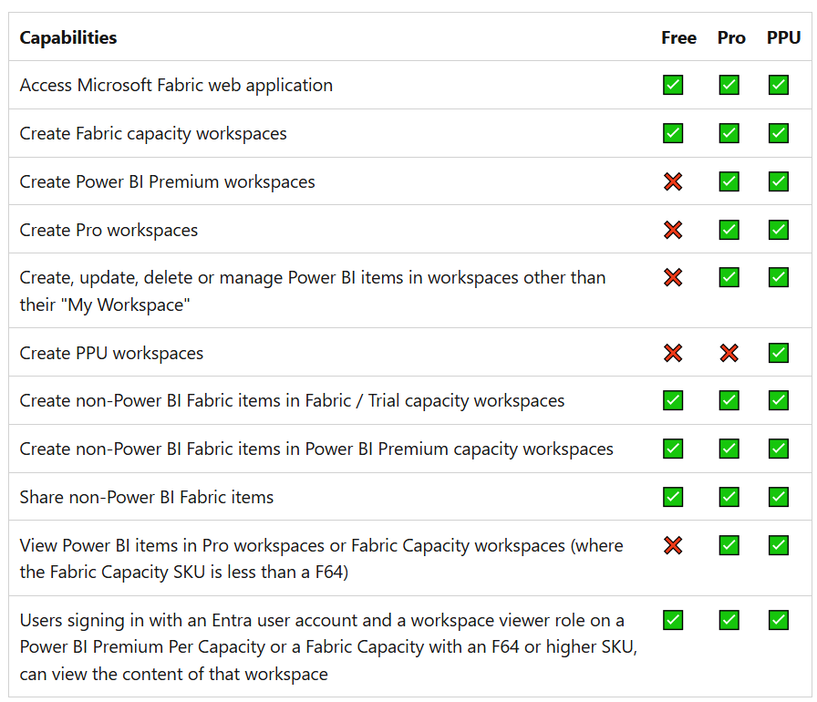
8

Slide 10
9
FABRIC DATA ENGINEERING
Lakehouse: A database-like collection of files, folders, and tables over a data lake, supporting big data processing with ACID transactions using Delta tables.
Notebook: An interactive multi-language tool for coding, data processing, visualization, and machine learning, with orchestration support.
Spark Application: A user-written program (Scala, Python, SQL, Java, .NET) that runs parallel Spark jobs for faster data processing.
Spark Job & Definition: A job runs tasks in parallel within an application; a job definition sets parameters for batch or streaming jobs.
V-Order: A write optimization for Parquet files, improving read speed, cost efficiency, and performance.

Slide 11
10
DATA FACTORY
Connector: Enables connections to various data stores for transformation.
Data Pipeline: Orchestrates data movement and transformation in Data Factory.
Dataflow Gen2: A low-code tool for data ingestion and transformation, offering advanced features over Gen1.
Trigger: Automates pipeline execution based on schedules or data conditions.

Slide 12
11
FABRIC DATA SCIENCE
Data Wrangler: A notebook-based tool for data exploration, cleansing, and generating reusable scripts.
Experiment: The main unit for organizing and controlling machine learning runs.
Model: A trained file that recognizes patterns using algorithms and data.
Run: A single execution of model code, tracked within an experiment.

Slide 13
12
FABRIC DATA WAREHOUSE
SQL Analytics Endpoint: Each Lakehouse includes a SQL endpoint that enables users to query Delta tables using T-SQL over TDS.
Fabric Data Warehouse: A traditional data warehouse with full transactional T-SQL capabilities for enterprise-level data management.

Slide 14
13
REAL-TIME INTELLIGENCE
Activator: A no-code/low-code tool for creating alerts, triggers, and actions on data streams.
Eventhouse: A solution for real-time data ingestion, processing, and analysis within a workspace.
Eventstream: A no-code tool for capturing, transforming, and routing real-time events.
KQL Database: Stores data for executing KQL queries within an Eventhouse.
KQL Queryset: Runs queries, views results, and allows saving or sharing queries for future use.

Slide 15
REAL-TIME HUB
14
Centralized Streaming Management – Captures and processes real-time events from multiple sources in one place.
No-Code & Low-Code Experience – Simplifies stream processing with an intuitive interface.
Integration with Fabric Services – Works with Eventstreams, Eventhouse, KQL databases, and Activator for efficient data handling.
Real-Time Insights & Actions – Enables businesses to monitor data flows and trigger actions based on live data.

Slide 16
15
ONELAKE
Shortcuts in OneLake are objects that link to other storage locations, either inside or outside OneLake. They appear as folders and function like symbolic links.
Shortcut Path – The location where the shortcut appears.
Target Path – The storage location the shortcut points to.
Independent Object – Deleting a shortcut doesn’t affect the target.
Potential Breakage – Moving, renaming, or deleting the target can break the shortcut.

Slide 17
16
WHAT IS TASK FLOW?
Fabric Task Flow is a workspace feature that visualizes the flow of work, showing how items are connected.
Key Benefits:
Better Navigation – Helps manage complex workspaces.
Improved Collaboration – Keeps teams aligned on design and development.
Standardized Workflows – Ensures consistency across tasks.
Enhanced Efficiency – Simplifies workspace organization and navigation.

Slide 18
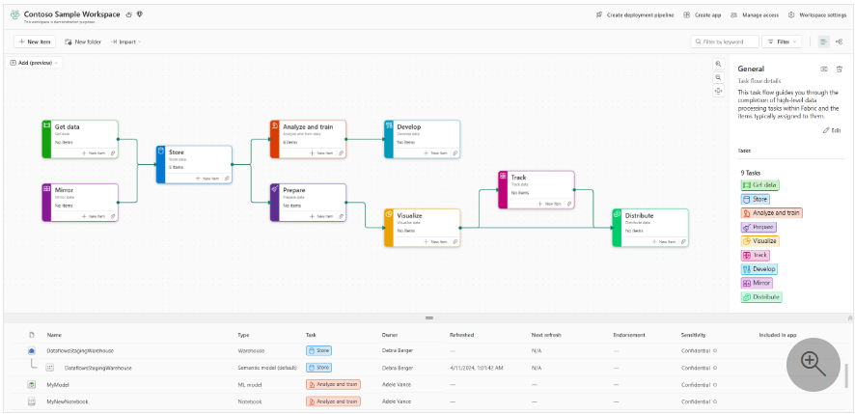
17

Slide 19
18
Task Flow
A task flow is a collection of connected tasks representing relationships in a process to complete an end-to-end data solution. Each workspace has one task flow, which can be built from scratch or customized from predefined templates.
Key Components:
Task – A unit of process within a task flow, guiding item selection and navigation.
Task Type – Classification of tasks based on their role in the data process flow.

Slide 20
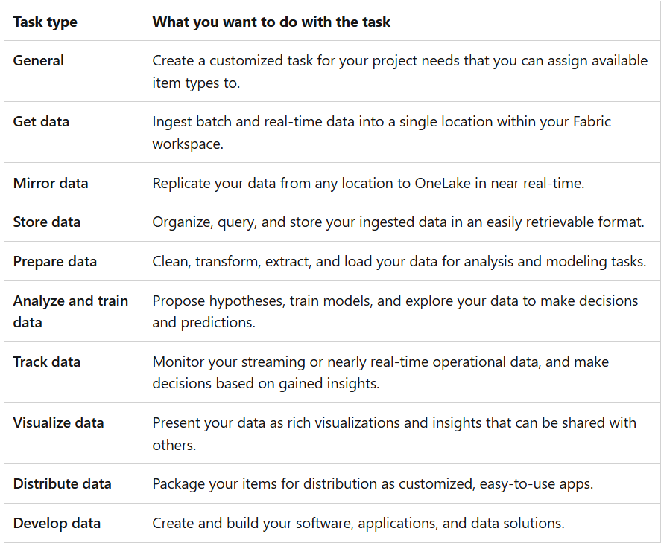
19

Slide 21
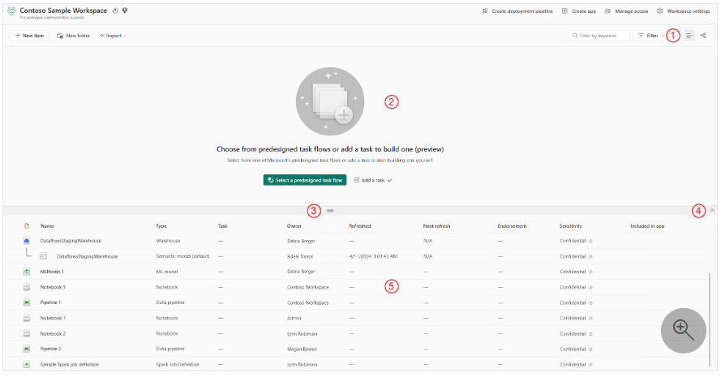
OPEN THE WORKSPACE
20

Slide 22
21
List view selector
Task flow canvas
Resize bar
Show/hide task flow
Items list

Slide 23
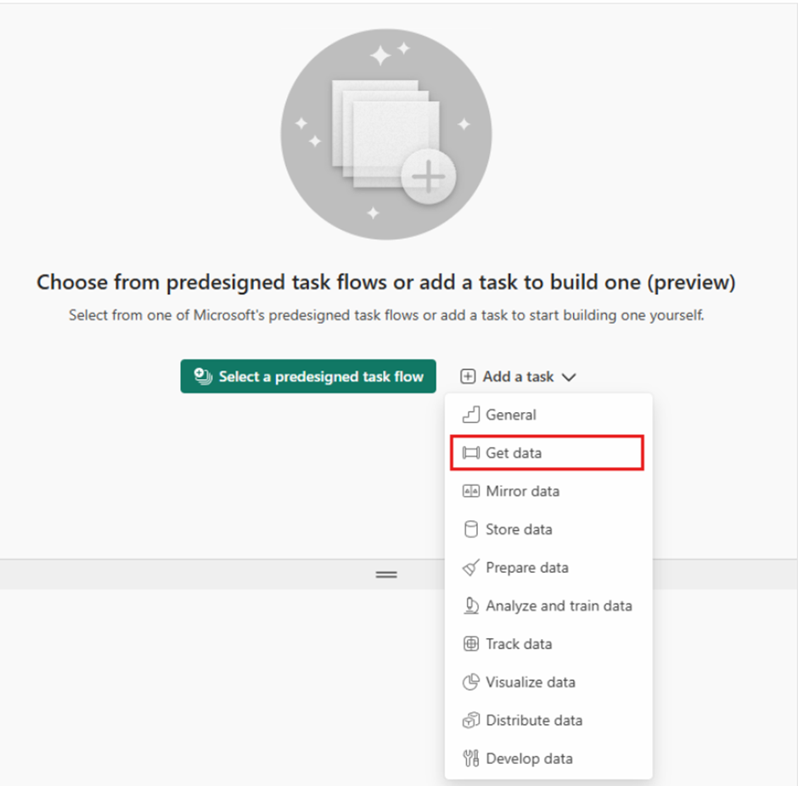
START WITH A CUSTOM TASK FLOW
22
1.In the empty task flow area, select Add a task and choose a task type.

Slide 24
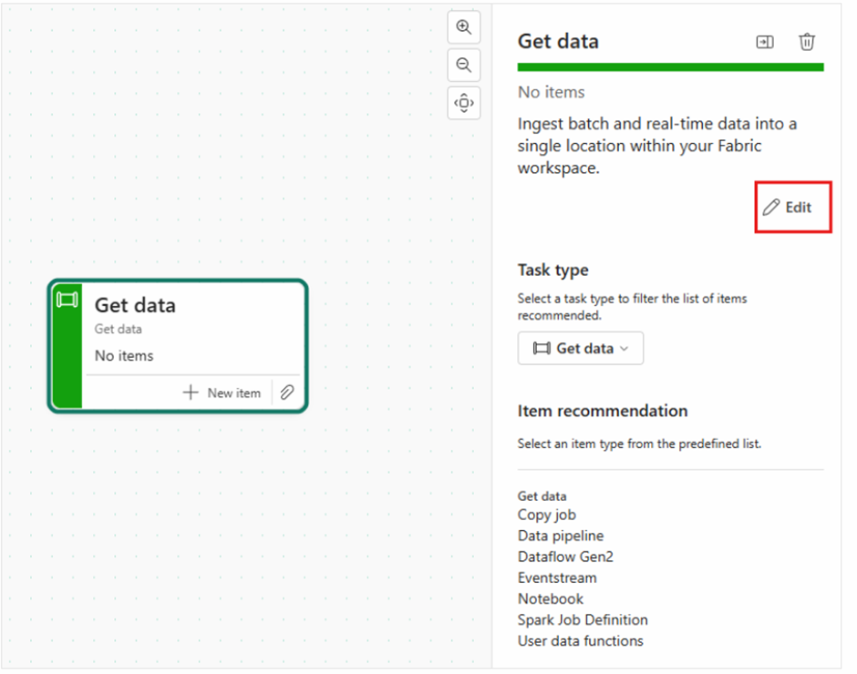
23
2.A task card appears on the canvas and the task details pane opens to the side.

Slide 25
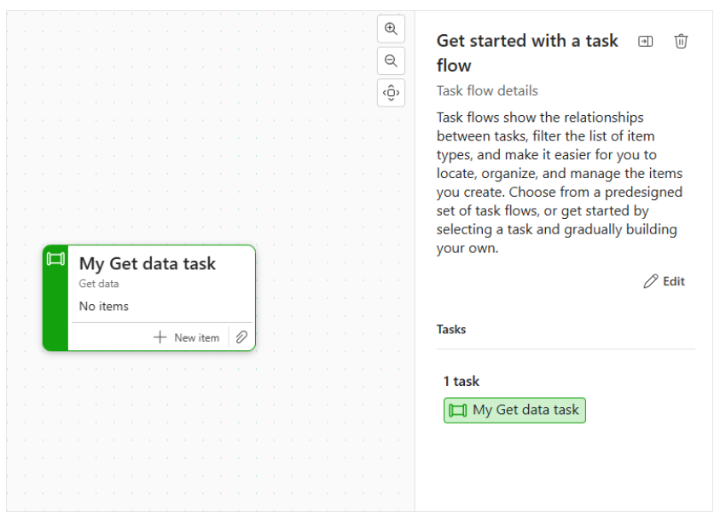
24
3. Deselect the task by clicking on a blank area of the task flow canvas. The side pane will display the task flow details with a default name (Get started with a task flow) and description. Note that the task you just created is listed under the Tasks section.

Slide 26
THANK YOU

